Slide 1
Cause of Death Case Study Presentation
Prepared by : Suneha sengar SME:miss. khushboo GARG
Internship batch 34

Slide 2

Agenda
Introduction
Objective
Exploratory Data Analysis (EDA)
Visualization
Inference
Future Work

Slide 3
Introduction
What is Cause of death projectt?
In this project, we have Historical Data of different cause of deaths for all ages around the World. The key features of this Dataset are: Meningitis, Alzheimer's Disease and Other Dementias, Parkinson's Disease, Nutritional Deficiencies, Malaria, Drowning, Interpersonal Violence, Maternal Disorders, HIV/AIDS, Drug Use Disorders, Tuberculosis, Cardiovascular Diseases, Lower Respiratory Infections, Neonatal Disorders, Alcohol Use Disorders, Self-harm, Exposure to Forces of Nature, Diarrheal Diseases, Environmental Heat and Cold Exposure, Neoplasms, Conflict and Terrorism, Diabetes Mellitus, Chronic Kidney Disease, Poisonings, Protein-Energy Malnutrition, Road Injuries, Chronic Respiratory Diseases, Cirrhosis and Other Chronic Liver Diseases, Digestive Diseases, Fire, Heat, and Hot Substances, Acute Hepatitis.

Slide 4
What are the benefits of Cause of Death project?
helps in analysing trends of disease with passing years.
helps in policy formulation related to health.
enable evidence based decision making.
helps in plugging loopholes in heath infrastructure
enable equitable resource distribution
empower citizen regarding their health status.
to minimise DALY and mortality.

Slide 5
ABOUT DALY.
The sum of mortality and morbidity is referred to as the ‘burden of disease’ and can be measured by a metric called ‘Disability Adjusted Life Years‘ (DALYs). DALYs are measuring lost health and are a standardized metric that allow for direct comparisons of disease burdens of different diseases across countries, between different populations, and over time. Conceptually, one DALY is the equivalent of losing one year in good health because of either premature death or disease or disability. One DALY represents one lost year of healthy life. The first ‘Global Burden of Disease’ (GBD) was GBD 1990 and the DALY metric was prominently featured in the World Bank’s 1993 World Development Report. Today it is published by both the researchers at the Institute of Health Metrics and Evaluation (IHME) and the ‘Disease Burden Unit’ at the World Health Organization (WHO), which was created in 1998. The IHME continues the work that was started in the early 1990s and publishes the Global Burden of Disease study

Slide 6
Objective
The objective is to apply the analytical skills to provide findings and conclusion that would help to predict cause of death in a year and in a country using the data provided over period of time.
Using the EDA I was tasked to provide the relationship between various variable and determine most influential variable (death reason) .

Slide 7






Exploratory Data Analysis (EDA)
Requirements | Tools Used
Hardware | RAM: 8 GB CPU : AMD Ryzen 5 3550H with Radeon Vega Mobile Gfx 2.10 GHz GPU : AMD Radeon ™ Vega 8 Graphics and NVIDIA GeForce GTX 1650 Ti
Software | Programming language : Python Distribution : Anaconda Navigator Browser based language shell : Jupyter Notebook
Libraries/Packages | Pandas NumPy matplotlib seaborn scikit-learn

Slide 8
Shape : 269 rows and 71 columns.
No null values present.
22% duplicate fields/records found.
Datatypes of all the columns are objects except for the “Pin Code" column which has integers.
First I imported the necessary libraries and loaded the entire dataset in our Jupyter Notebook and renamed the columns.
secondly, checked the shape of dataset.
Thirdly, i checked the column names
fourthly, i checked the null values
fifthly, i checked datatypes of each columns
sixthly, i checked the entries having 0

Slide 9
Visualization
What is Data Visualization? Data visualization is defined as a graphical representation that contains the information and the data.
Benefits of Good Data Visualization? Data visualization is another technique of visual art that grabs our interest and keeps our main focus on the message captured with the help of eyes.
Different Types of Analysis for Data Visualization are Univariate Analysis: In the univariate analysis, we will be using a single feature to analyze almost all of its properties. Bivariate Analysis: When we compare the data between exactly 2 features then it is known as bivariate analysis. Multivariate Analysis: In the multivariate analysis, we will be comparing more than 2 variables.

Slide 10
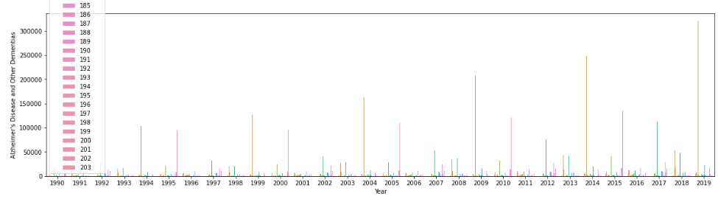
Bivariate Analysis:
here country specific prevalance of disease of different year is analysed.
Though the graph is not visible clearly, it show that poor countries are more susceptible to diseases of all types whereas rich countries are mostly showing poor lifestyle induced illness.

Slide 11
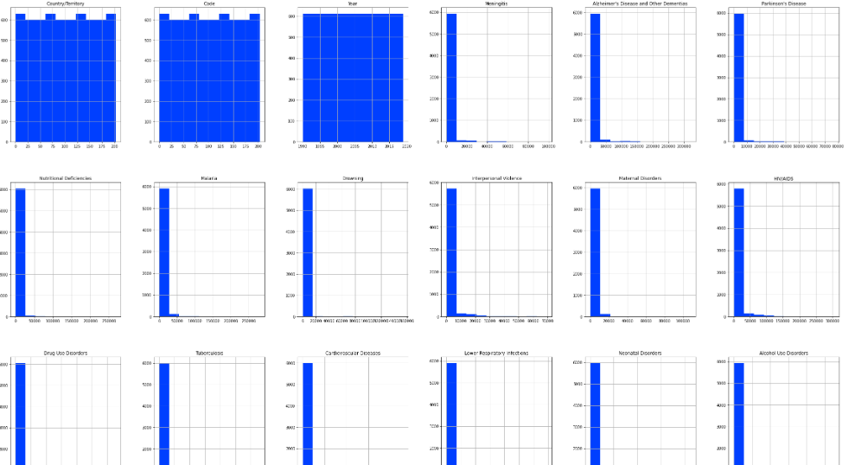
Multivariate Analysis:
I used the histogram after encoding all the columns of our dataset.
Since histogram only understand numeric values it would not have generated a diagrammatic representation of object datatype columns.
Once the encoding was complete the histograms showed the information.

Slide 12
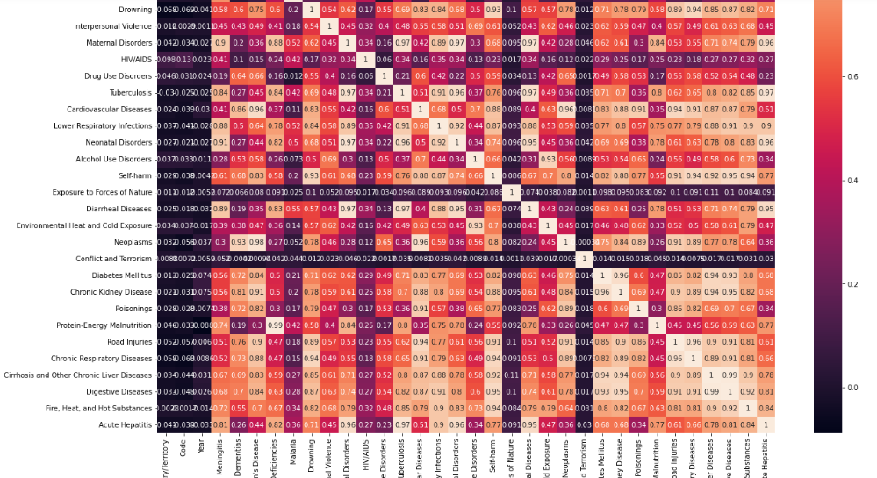
Multivariate Analysis:
I used the heatmap on the encoded dataset to see the correlation details between the columns.
Even on the Jupyter Notebook the picture was too tiny however seeing the color combinations I was able to figure out that there is no multi collinearity concern between the columns.

Slide 13
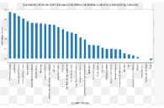
Correlation between the columns.
With the help of correlation technique I generated separate bar plots to check the positive and negative correlation details in our dataset.
Positive correlation - A correlation of +1 indicates a perfect positive correlation, meaning that both variables move in the same direction together.
Negative correlation - A correlation of –1 indicates a perfect negative correlation, meaning that as one variable goes up, the other goes down.

Slide 14
Inference
folllowing inference can be drawn from EDA on Cause of Death Project:
1.Every other disease is related to other eg protein and eneregy malnutrition is related to alzheimer and dementia disease or chronic liver disease. etc
2.Almost all disease are preventable with good social, cultural and medical determinant of heath. eg equitable distribution of helath resource, safe water and sanitation, good environment etc
3.There are 203 different countries covered in survey. Poor countries suffer from “disease of underdevelopment” whereas Rich countries suffer from “poor lifestyle induced disease”
4.Need for early maternal and child care to minimise the DALY.
5.There are some social determinant of health viz interpersonal relationship, war etc that need to be taken care of.
6.There are some environmental determinant of health viz clean air, water, etc that need to be taken care of to handle disease viz diarrhea, malaria etc

Slide 15
FUTURE WORK
country specific FOCUS IS REQUIRED EG
U.S, BRUNIE, ANDORRA REQUIRE INTERVENTION IN DISEASES VIZ CARDIOVASCULAR DISORDER ETC
AFGHANISTAN , GUINEA ETC REQUIRE INTERVENTION FOR MALARIA, DIARRHEA, RESPIRATORY DISORDER ETC

Slide 16


